Slide 1
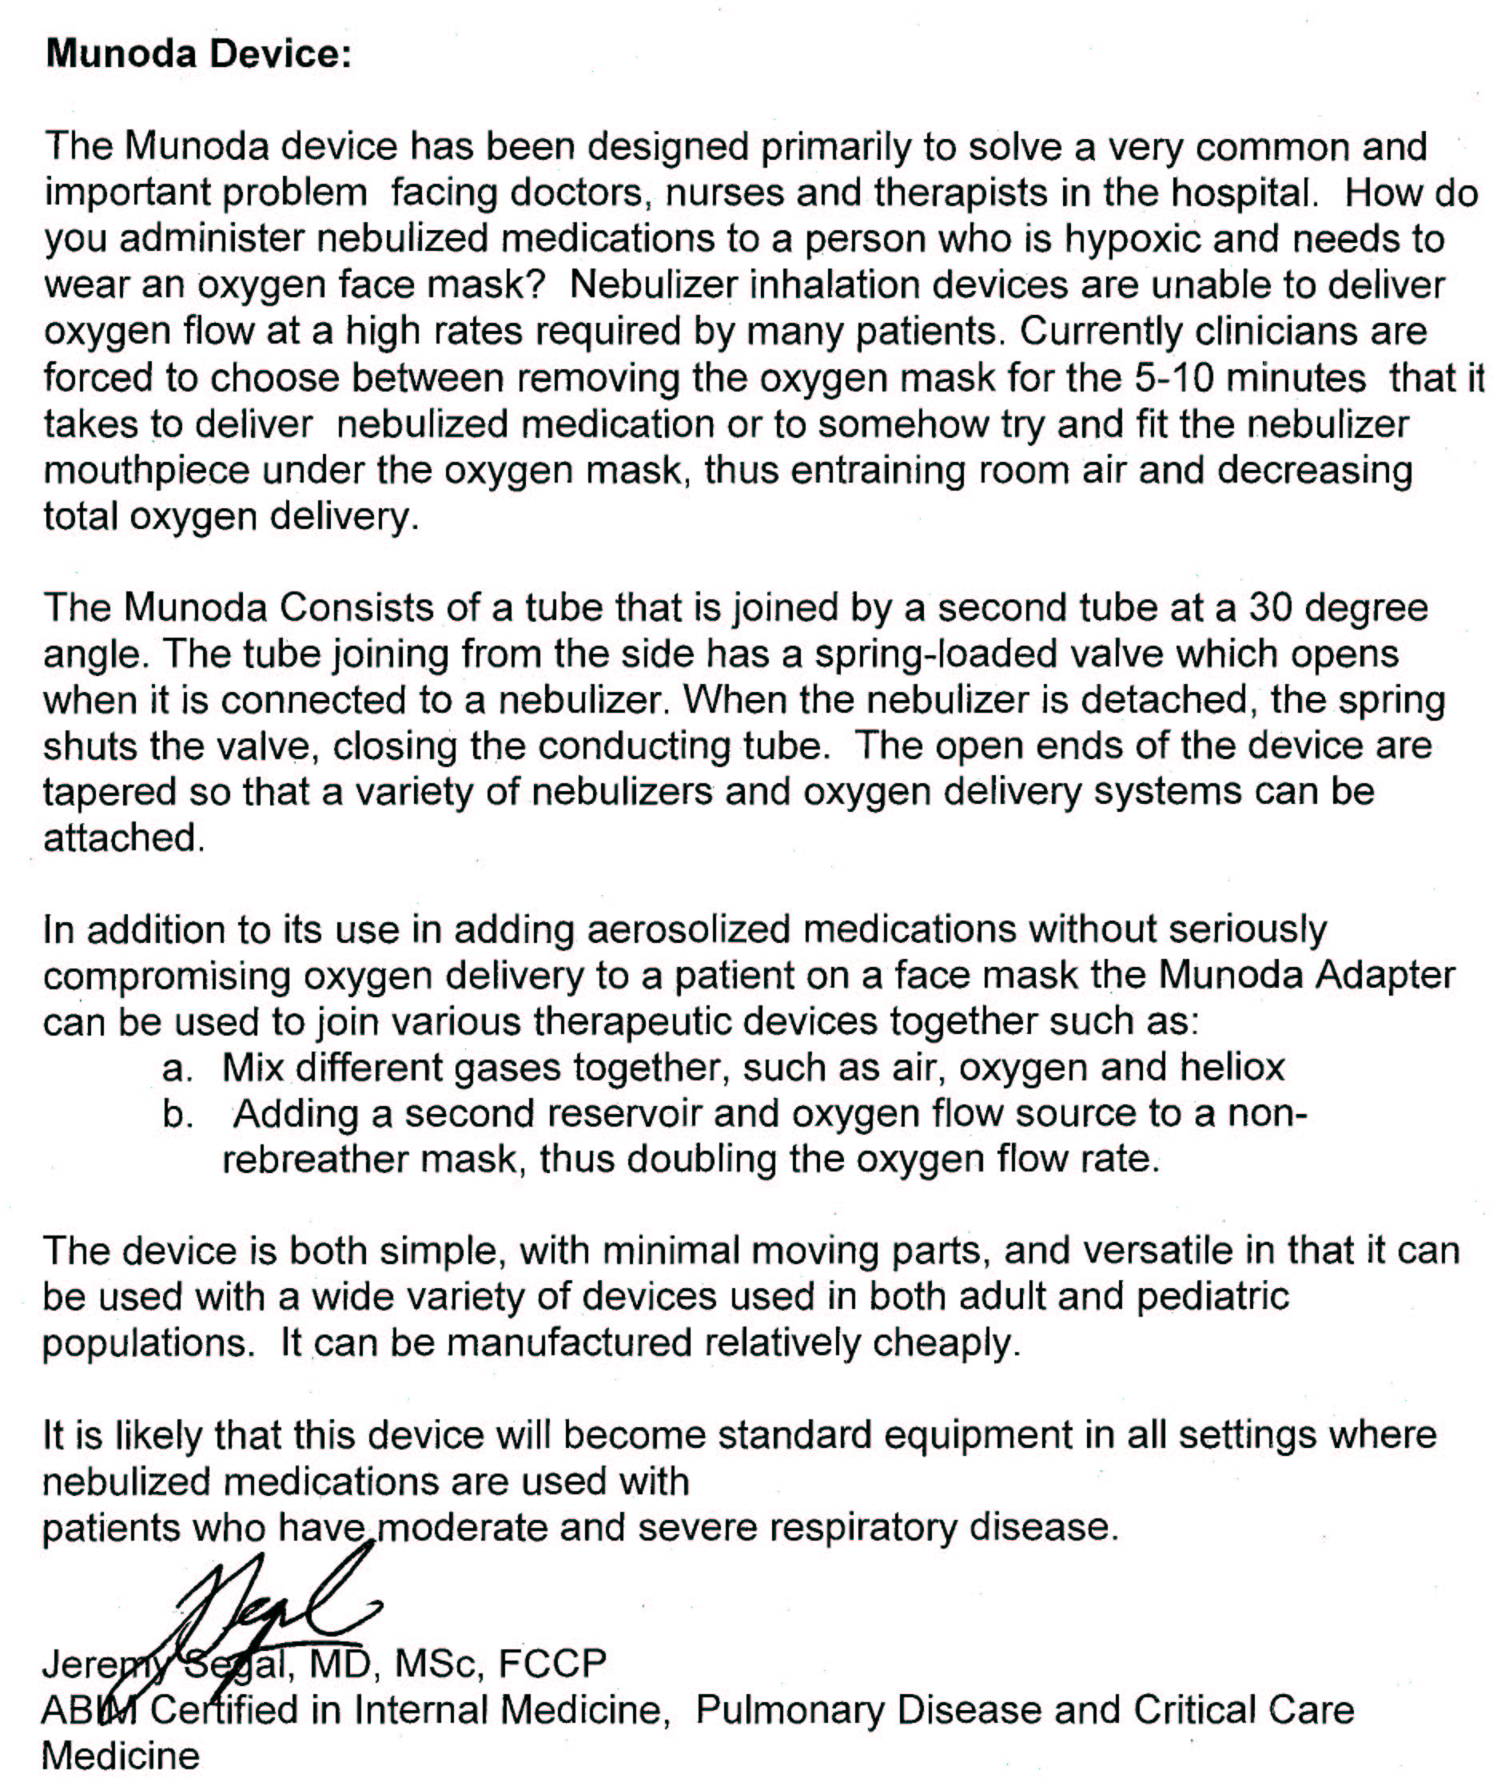
CLINICAL REVIEWS BY MEDICAL DOCTORS FOR MUNODA/SINODA®

Slide 2
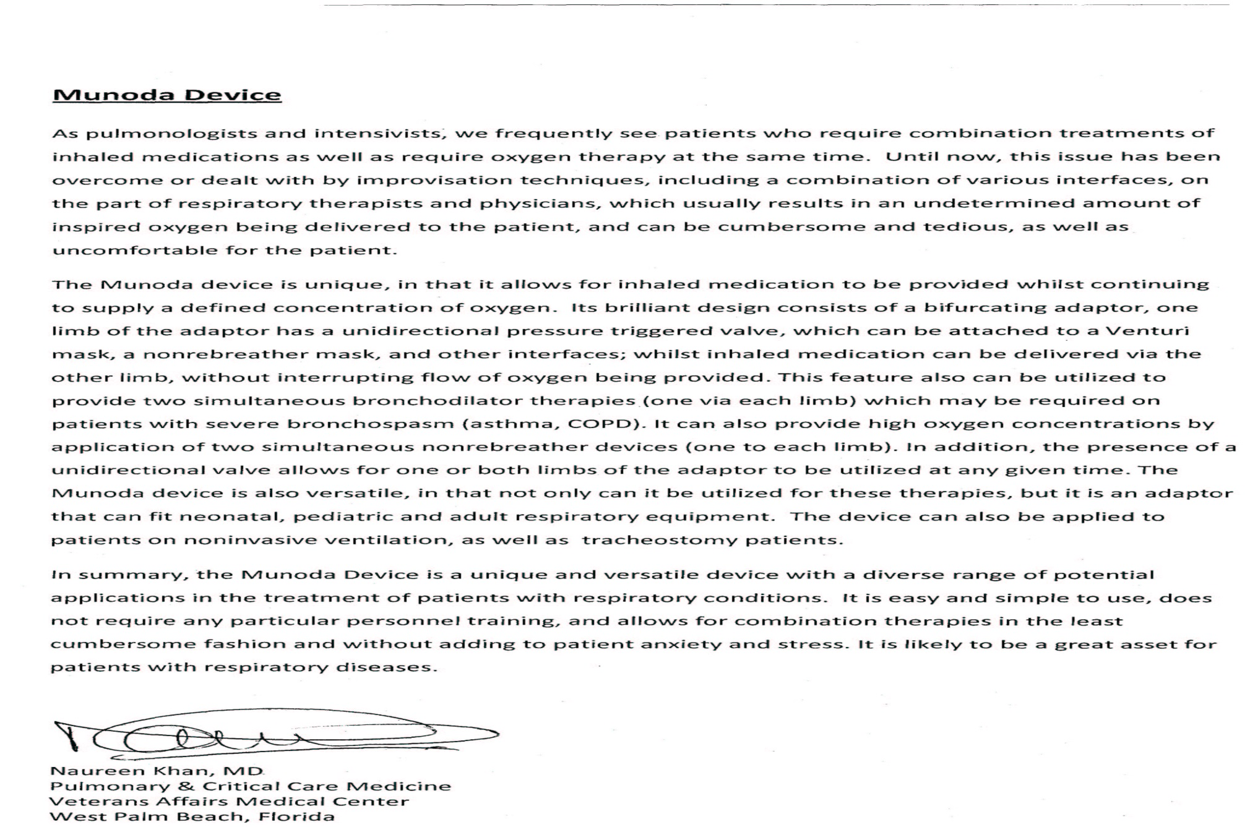
CLINICAL REVIEWS BY MEDICAL DOCTORS FOR MUNODA/SINODA®

Slide 3
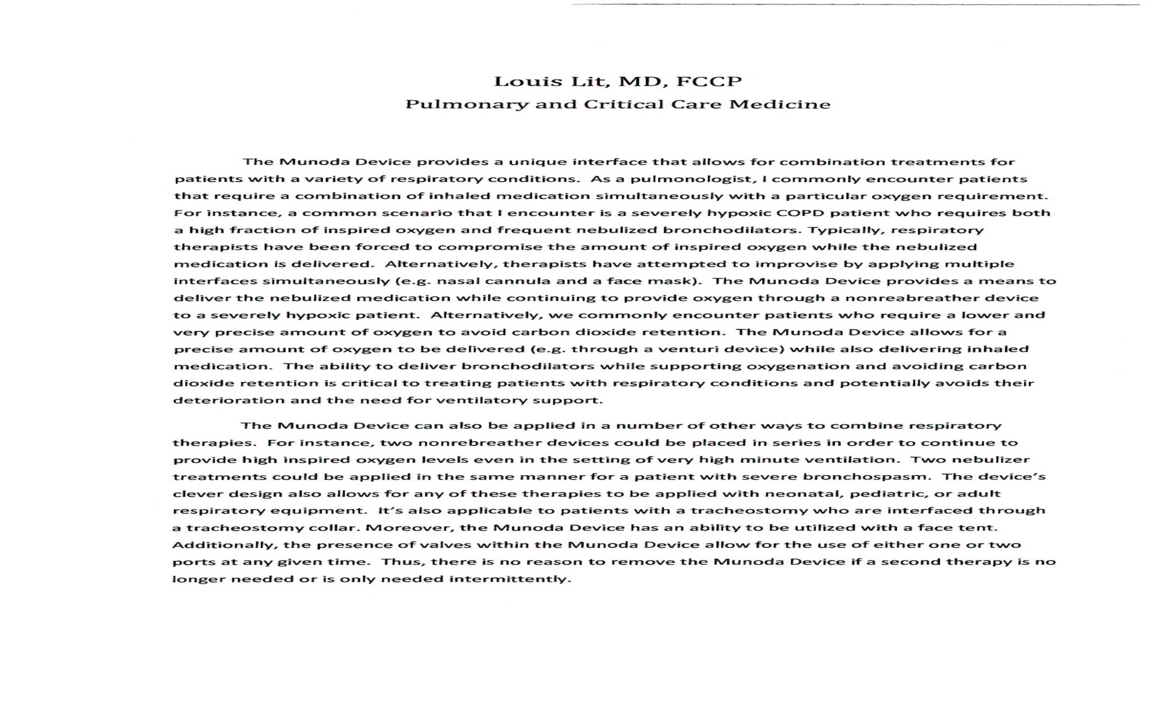
CLINICAL REVIEWS BY MEDICAL DOCTORS FOR MUNODA/SINODA®

Slide 4
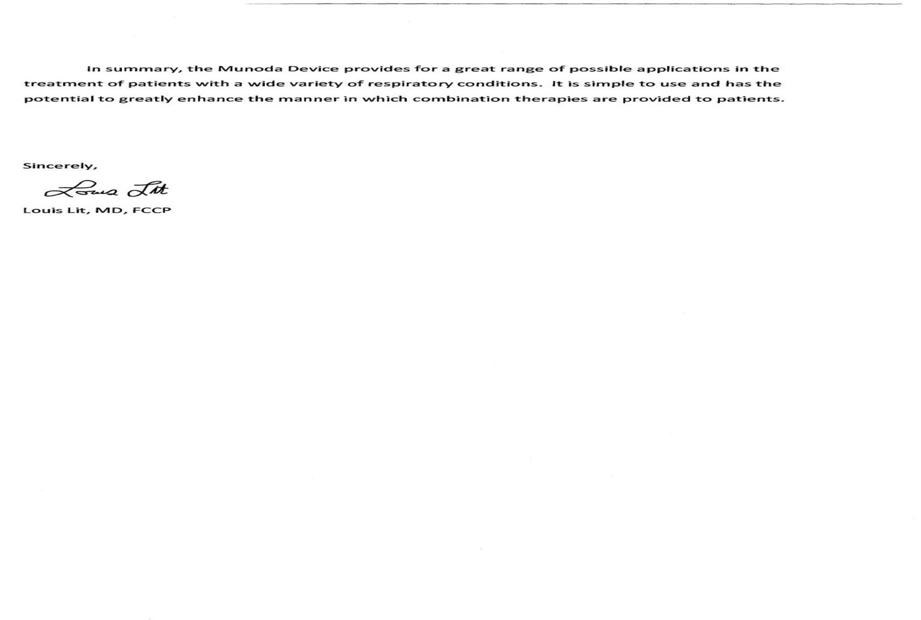
CLINICAL REVIEWS BY MEDICAL DOCTORS FOR MUNODA/SINODA®

Slide 5
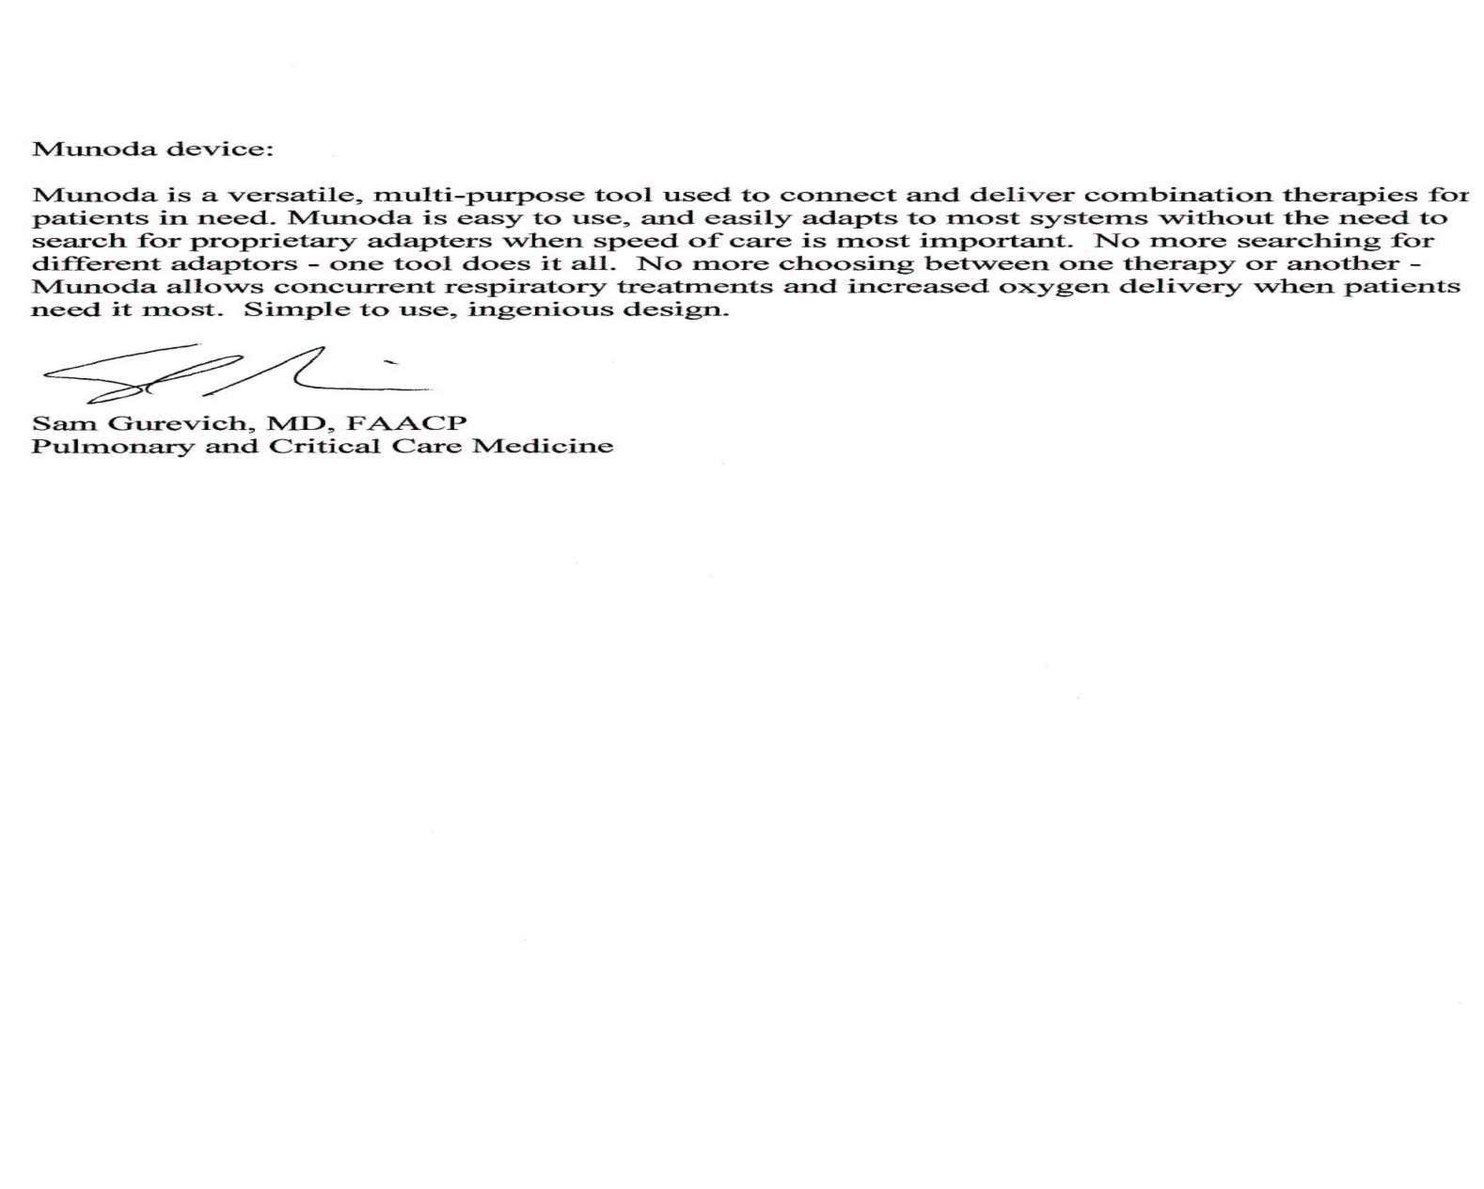
CLINICAL REVIEWS BY MEDICAL DOCTORS FOR MUNODA/SINODA®

